Slide 1
website traffic history dataset

Slide 2
GROUP 7
Divyajot Singh MANKAN
Pratinav Jinwal
Shubham Kharbanda
Karan Tejraj Kotian
IQBALDEEP SINGH BHULLAR

Slide 3
INTRODUCTION
Aim: To apply five forecasting techniques to predict future website traffic based on historical data. This involves analyzing daily visitor statistics to forecast unique visits.
Dataset: Spans from September 14, 2014, to August 19, 2020, or nearly 6 years of website visitor statistics.
Notes:
This dataset is a collection of key metrics that track the number of individuals visiting a website each day, providing us with valuable insights into the website's performance and user engagement over time.
Date: Each record corresponds to a specific day, allowing us to observe patterns over time.
Page Loads: This measures the total number of page views, giving us an idea of overall website activity.
Unique Visits: Here, we focus on individual users, which helps us understand our daily reach.
First-Time Visits vs. Returning Visits: These metrics help us distinguish between new and repeat users, offering insights into user retention and the appeal of the website to first-time visitors.

Slide 4
Linear regression
TECHNIQUES USED
MOVING AVERAGE METHOD
Utilizes Simple Moving Average (SMA) techniques to identify unique visits over time.
Exponential Smoothing Method
It is particularly suitable for capturing short-term trends and smoothing out noise in the data..
LONG SHORT-TERM MEMORY
Useful for modeling and forecasting time series data due to its ability to learn and remember long-term dependencies within the data.
ARIMA / SArima
ARIMA (Autoregressive Integrated Moving Average) SARIMA (Seasonal Autoregressive Integrated Moving Average)
Used to predict the value of a variable based on the value of another variable.

Slide 5
MOVING AVERAGE METHOD
Analyzed 5-period and 10-period SMA
MAE: The Mean Absolute Error shows a decrease as we move from a 5-day to a 10-day MA for both forecasting categories. This suggests that the forecasts become closer to the actual values, on average, with a longer moving average period.
MSE and RMSE: Both Mean Squared Error and Root Mean Squared Error exhibit significant decreases when the period of the moving average is extended. This reduction in MSE and RMSE indicates not only that the average error magnitude is lower but also that large errors become less frequent, as MSE is particularly sensitive to larger errors due to its squaring of differences.
Metric | Unique Visits (5-day MA) | Unique Visits (10-day MA)
MAE (Mean Absolute Error) | 649.7 | 556.6
MSE (Mean Squared Error) | 561,242 | 429,647
RMSE (Root Mean Squared Error) | 749.2 | 655.5

Slide 6
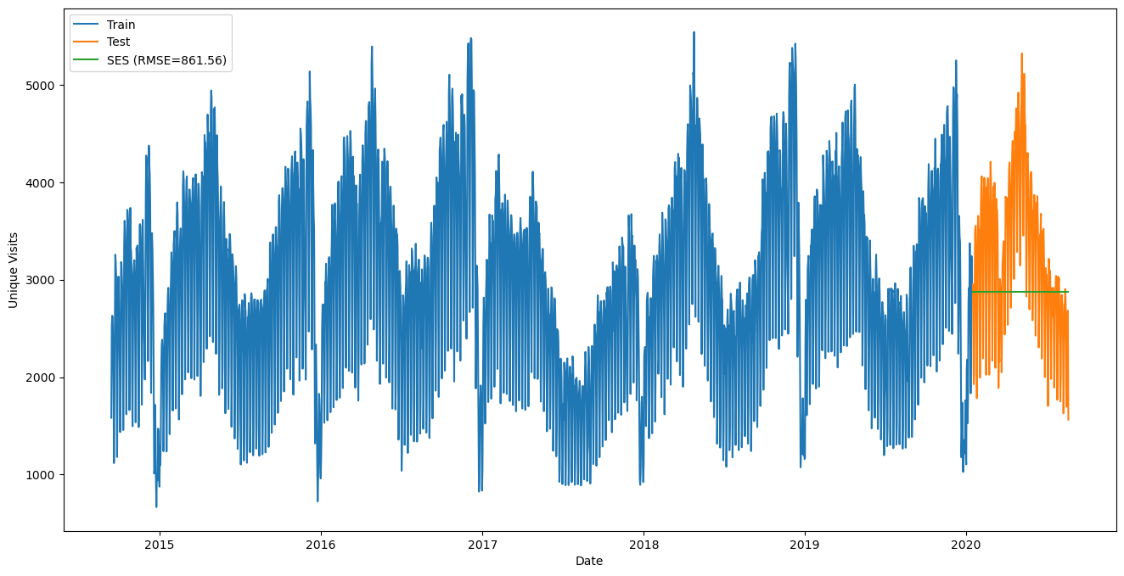
Exponential smoothing
It assigns exponentially decreasing weights to past observations, giving more importance to more recent observations. It does not consider trend or seasonality, making it simpler than models like ARIMA or Holt-Winters that can account for these components.
Key Metrics
 | MAE | MSE | RMSE
Single Exponential | 689.78 | 742,289 | 861.56
Triple Exponential | 1,442.58 | 3,432,239.30 | 1,852.63
Notes:
Simplifies forecasts by considering only exponentially decreasing weights to past observations:
Simple Exponential Smoothing (SES) assigns exponentially decreasing weights to past observations, giving more importance to more recent observations. It does not consider trend or seasonality, making it simpler than models like ARIMA or Holt-Winters that can account for these components.
Shows Moderate Accuracy for simple data patterns:
Based on the RMSE value provided, we can say that the SES model has moderate accuracy. However, the term "moderate" is relative; whether this level of accuracy is acceptable depends on the context of the data and the specific requirements for the forecasting task. Given that the RMSE is 861.56, the model's forecasts are, on average, 861.56 units away from the actual observed values. Whether this is moderate or not would depend on the scale and variance of your data.
Have lower metrics like MAE, RMSE:
The statement should clarify that "lower" refers to the quality of the forecast. Lower values of MAE and RMSE indicate better forecast accuracy. The RMSE provided is 861.56, which, without additional context, we cannot definitively label as "low" or "high." It is a measure of the average magnitude of the forecast errors. To determine if this is indeed low, one would need to compare it against the range of the data, the RMSE of other models, or industry benchmarks for similar forecasting tasks.

Slide 7
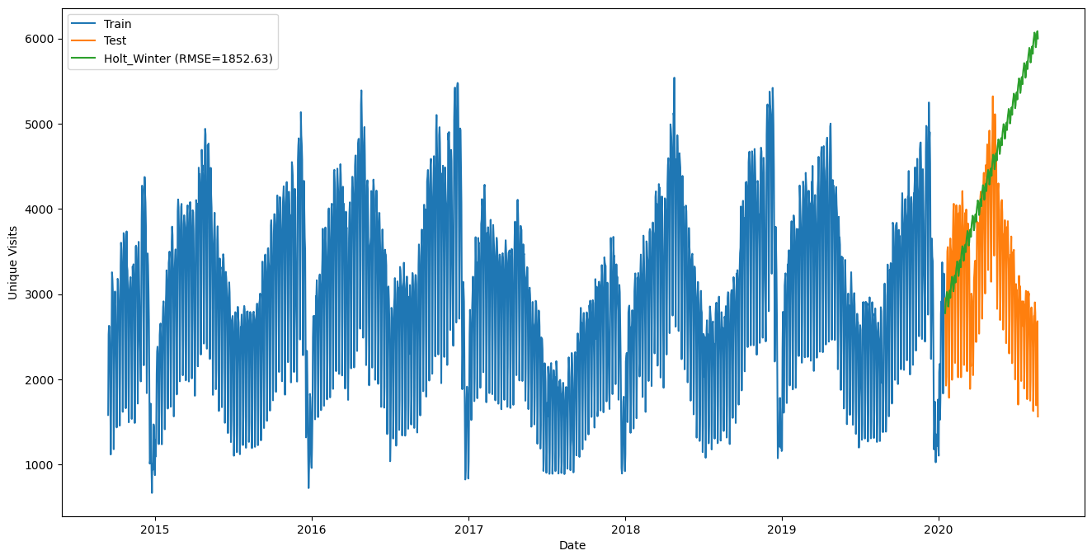
TRIPLE Exponential smoothing
The Holt-Winters model accounts for level, trend, and seasonal components in the data, which can make it a strong model for time-series forecasting where these components are present.
An RMSE of 1852.63 suggests the model's predictions are, on average, 1852.63 units away from the actual values.
Notes:
Incorporates seasonality, trend, and level components, making it more sophisticated:
The Holt-Winters model accounts for level, trend, and seasonal components in the data, which can make it a strong model for time-series forecasting where these components are present.
Having higher error metrics indicating better accuracy in capturing complex data:
This point is incorrect. Higher error metrics, such as a higher RMSE, indicate lower accuracy. You want lower RMSE values for better model performance. In the context of your image, an RMSE of 1852.63 suggests the model's predictions are, on average, 1852.63 units away from the actual values. This value needs to be considered relative to the scale of your data to determine if it indicates good predictive accuracy.
Based on the image, the Holt-Winters model has provided a forecast that follows the general trend of the test data but may not capture all the nuances, especially considering the RMSE provided. If we compare this to LSTM models, which are capable of capturing more complex patterns due to their ability to learn from sequences of data, an LSTM might potentially achieve a lower RMSE if it can better capture the underlying patterns in the time series.

Slide 8
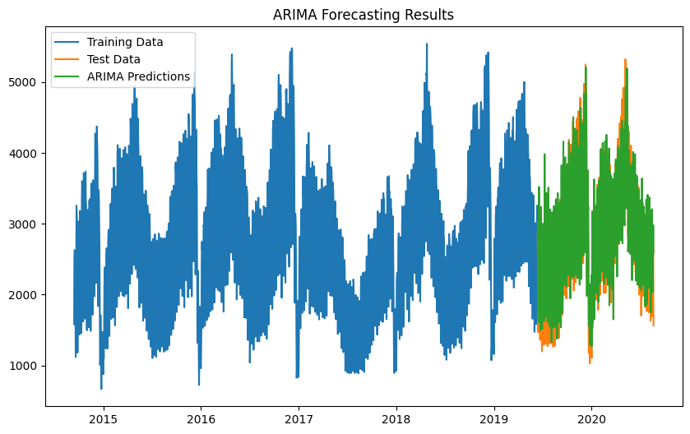
ARIMA
Identify what order of model will be the best fit.
In order to choose the best order for an ARMA model you have to do a search over lots of potential model orders to find the best set. (use a for loop). Evaluate using AIC and BIC statistic to choose the best model.
Fit the model and look at the summary statistics to generate the forecasting.
Mean absolute Error (MSE): 389.6937544508512
Root Mean Squared Error (RMSE): 478.1940529013412

Slide 9
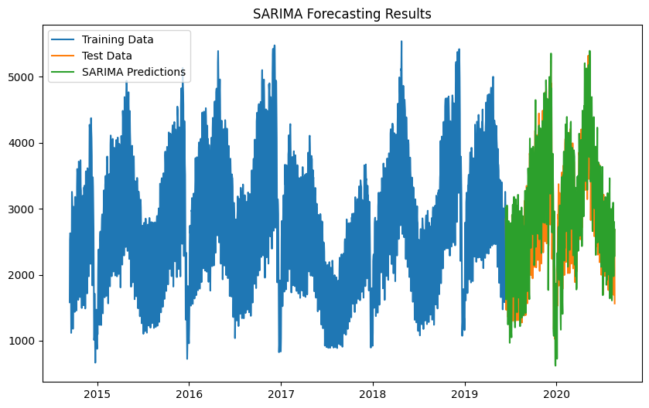
SARIMA
Subsequently, we employed SARIMA, which resulted in a lower Root Mean Squared Error (RMSE) of 405.41955506111105, indicating a better fit compared to ARIMA.
Key Metrics
 | MSE | RMSE
SARIMA | 164365.01562594928 | 405.41955506111105

Slide 10
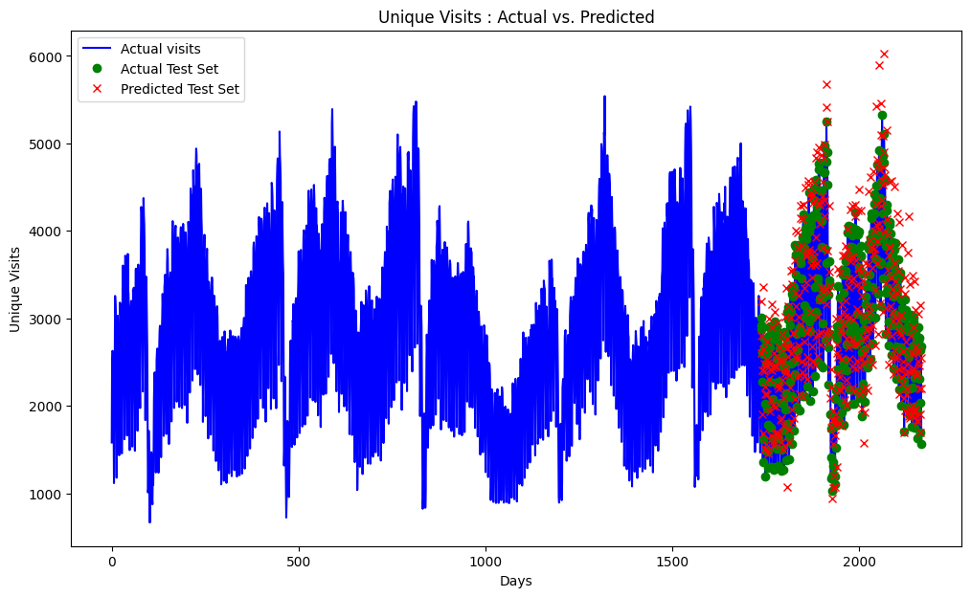
LONG SHORT-TERM MEMORY
Our approach utilizes an LSTM model with a 04-step input sequence. The core of our methodology lies in the LSTM architecture. Our model consists of LSTM layers followed by a dense layer reflecting web traffic data, to predict the unique visits for the following day.
Error Metrics:
MAE: 254.17
RMSE : 353.02
Notes:
Prepare Dataset for LSTM
From Time Series to Supervised Learning: Time series data must be transformed into a supervised learning format, which is essentially a 2D structure with samples and features.
3D Data Structure for LSTM: LSTMs require the input data to be in a three-dimensional format comprising:
Samples: Each sequence is one sample.
Time Steps: Each time step is one point of observation in the sample.
Features: Each feature is one observation at a time step.
The graph displays a time series analysis where the blue line represents the actual historical sales data, characterized by a clear seasonal pattern. The green dots represent actual data points designated for testing the model's predictions, which appear to align well with the historical data. The red crosses represent the predicted sales, which follow the overall trend and seasonality but with some deviations, especially at the peaks and troughs of the sales pattern. The model seems to capture the general cycle of the sales data, but there is room for improvement in prediction accuracy.
RMSprop adjusts the learning rate for each weight in the neural network individually. It does this by keeping a moving average of the squares of the gradients for each weight. At each step, RMSprop divides the learning rate by the square root of this moving average. This normalization step is meant to even out the rate at which weights are updated, particularly in cases where the gradient can be very small or large, and stabilizes the training process.

Slide 11
Linear regression
Linear regression is a statistical method used for modeling the relationship between a dependent variable and one or more independent variables by fitting a linear equation to observed data. Linear Regression is chosen due to its suitability for predicting a continuous dependent variable (Unique Visits) based on an independent time variable (Days).
Steps taken:
To evaluate the model’s performance accurately by training with a subset of data and testing with a separate set. The dataset is splitted into 80% training data and 20% testing data using a fixed random seed (random_state=42) to ensure reproducibility.
The model is trained using the 'Days' as the predictor and 'Unique Visits' as the response variable.
Interpretation: Coefficients represent the change in the number of unique visits for each additional day. The intercept indicates the predicted number of visits at day zero.
Evaluating Model Performance: Mean Squared Error (MSE):979424.136689424
Coefficient of Determination (R²): -0.0010010885434541539

Slide 12
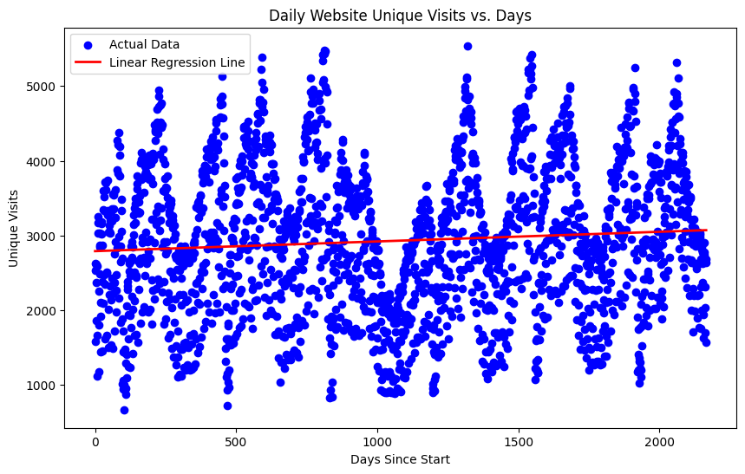
Linear regression
The goal of the linear regression algorithm is to get the best fit line. The best fit line is a line that has the least error which means the error between predicted values and actual values should be minimum.
In simple terms, the best fit line is a line that fits the given scatter plot in the best way.
Notes:
Linear Regression Line: The red line across the scatter plot is the result of a linear regression analysis. It represents the best fit straight line through the data points that minimizes the sum of squared differences between the observed values (actual unique visits) and the values predicted by the linear equation (predicted unique visits based on the regression line).
Interpretation: The linear regression line provides a simplified model of the trend in the data. Ideally, this line would show whether there's a general increase or decrease in website visits over time. However, the line in the graph appears to be relatively horizontal, suggesting that, according to the linear regression model, there isn't a strong trend of increasing or decreasing visits.

Slide 13
CONCLUSION
LSTM models stands out in forecasting because it can understand and use patterns over time in the data.
LSTM is highly effective at modeling the complexities and patterns in your dataset, likely because of its ability to capture temporal dependencies and long-term relationships in time-series data.
The time series data has long-term temporal dependencies that simpler time series models may not capture effectively. LSTMs are designed to remember information for long periods, which is crucial in such scenarios.
Linear Regression falls short as it doesn't handle time-based dependencies well and the r2 score is negative so, this model is not best fit for our dataset.
The Average prediction Accuracy from various Methods
Method | MAE | MSE | RMSE
Moving Average 5 days | 649.703 | 561,242 | 749.16
Moving Average 10 days | 556.15 | 429,647 | 655.47
Single Exponential | 743.72 | 831,176.70 | 911.69
Double Exponential | 6,526.27 | 60,213,379.21 | 7,759.73
Triple Exponential | 1,442.58 | 3,432,239.30 | 1,852.63
ARIMA | 389.69 | 228669.55 | 478.19
SARIMA | 313.24 | 164365.01 | 405.41
LSTM | 254.17 |  | 353.02
Linear Regression |  | 979424.136 | 989.65
Notes:
LSTM (Long Short-Term Memory) Networks have the lowest MAE, MSE, and RMSE scores, which indicates the highest level of accuracy among the methods listed. This suggests that LSTM is highly effective at modeling the complexities and patterns in your dataset, likely because of its ability to capture temporal dependencies and long-term relationships in time-series data.
SARIMA (Seasonal ARIMA) also shows relatively low error metrics and is the second-best performing model after LSTM. It handles both non-seasonal and seasonal components and is known to work well with data having trends and seasonal patterns, which are typical in website traffic.
ARIMA (AutoRegressive Integrated Moving Average) has a slightly higher error metric than SARIMA but still outperforms the simpler methods like Moving Averages and Exponential Smoothing, indicating it is a good fit for data with trends and non-seasonal patterns.
Single, Double, and Triple Exponential Smoothing Methods have higher error metrics compared to ARIMA and SARIMA, with Triple Exponential Smoothing (also known as Holt-Winters) having a particularly high RMSE. This suggests that these methods, while they incorporate smoothing, are not as effective as the more complex SARIMA and LSTM models at capturing the data patterns.
Moving Average Methods (5 days and 10 days) have lower performance than the more advanced models but still could be useful for very short-term forecasting and when computational simplicity is needed.
Linear Regression has the highest error metrics, which implies that it is the least suitable model for this dataset. This could be because linear regression does not take into account the sequential nature and time dependencies of the data.
Considering all the metrics, LSTM is the most accurate model for forecasting in this dataset, given its lowest MAE, MSE, and RMSE. This suggests that the LSTM model is able to understand and learn from the sequential nature of the data, which includes patterns over time that simpler models cannot capture.

Slide 14
THANK YOU

